Slide 1
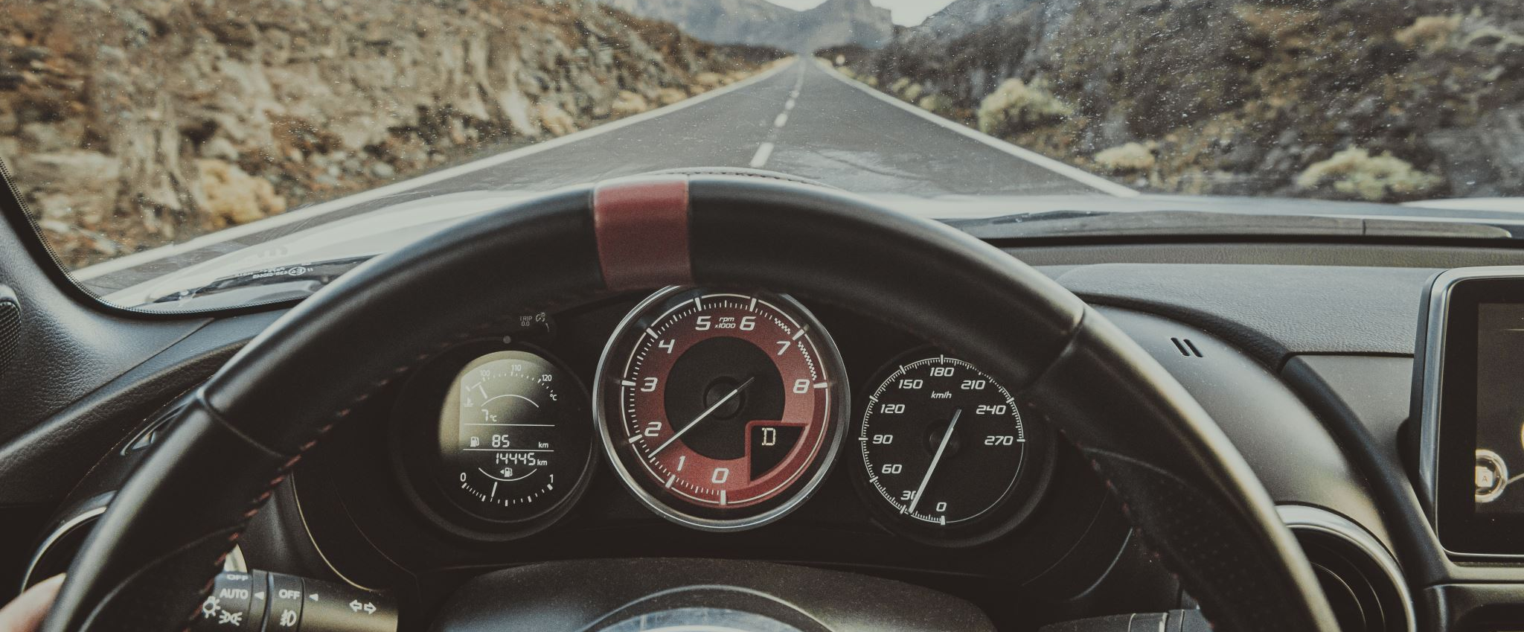
Driver Drowsiness detection
Model and prod and awareness raising

Slide 2
Description
Using webcam, detect wether a person looks drowsy and play alarm in this case
Detect if eyes are closed or open

Slide 3
Example (Wait for Gif to play)

Slide 4
Dataset
Eyes Open Closed Dataset (link here)
Kaggle
42.6k png files (32.6k files Train data, 14.6k files Test data)

Slide 5
Type of problem
CNN model that classifies whether a person’s eyes are ‘Open’ or ‘Closed’.
Use OpenCV Library (for Webcam)
TensorFlow with Keras
Pygame (to play sound)

Slide 6
Demo day
Notebook analysis or slides with relevant statistics and graphs about driver drowsiness and effects on accidents (as intro to topic).
Model in prod demonstrating model by having person sit in front of webcam.
Possibly link with algorithmic bias topic discussed in class
Conclude by raising awareness about dangers of driving with sleep deprivation and about dangers modern technologies can have (algorithmic bias)

